Slide 1


Field Communication & Emulation

Slide 2

Before Fieldbus
Transfer data from field device to HOST
Electrical interface used for carrier of analog data
4-20 mA (Scaled 0-100% level)
0-10 V (Scaled 0-5 bar)
Point to point connection
Scaling has to be known
No communication
Not possible to configure field device
One cable/device
Heavy installation
Many cables
Configure sensor tank by tank

Slide 3
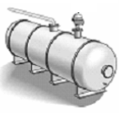
The “Fieldbus way”
Electrical interface used for carrier digital data
RS232, RS485
TRL/2
Communication Protocol
Decides how to interpret data
Modbus rtu, Hart, Profibus, FF
Multidrop network
Every field device has an address
Several devices/cable
Easy installation
Few cables
Configure sensors from one point

Slide 4
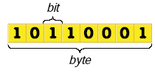
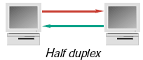
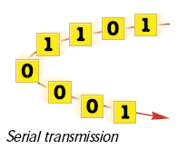
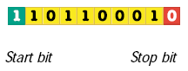
What is communication?
Electrical Interface
Defines how to transfer binary data
Voltage: RS232, RS485
Frequence modulated: TRL/2
Current loop
Transmission
Serial transmission
Half duplex / Full duplex
Communication Protocol
Set of rules how to interpret packets of binary codes
Modbus rtu, Hart, Profibus, FF

Slide 5
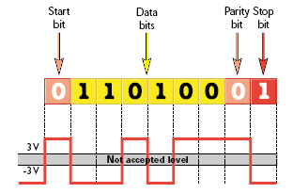
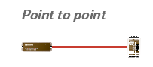
Electrical Interface
RS232
Point to Point Interface
Full duplex
Max 15m, 115200 baud
Easily disturbed
Not suitable for fieldbus

Slide 6
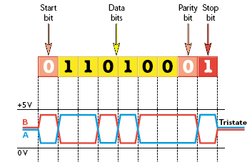
Electrical Interface
RS485
Half duplex
Max 1200m, 115200 baud
Multidrop
Only as straight bus
120 ohm termination needed
Robust against disturbance
Sensitive for voltage drop
Suitable for fieldbus
T
T

Slide 7
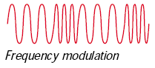
Electrical Interface
TRL/2 (Rosemount Standard)
Half duplex
Up to 4000m, 4800 baud
Multidrop
Straight bus
Star connection
Robust against disturbance
Not sensitive for voltage drop
Suitable for fieldbus
90 Khz
100 Khz
0
1
0
1

Slide 8
Communication protocol
Communication language
Defines
How to interpret binary data
How to speak/listen
When to speak/listen
Modbus rtu
Profibus
Modbus rtu
??
Level, temperature, pressure...
Bla..bla..bla.
☹
☺
Host
Field Device

Slide 9
Electrical Interface/Protocol
Same electrical interface – Different protocols
RS485
Modbus rtu
Profibus
GSI
Same Protocol – Different electrical interfaces
Modbus rtu
RS232
RS485
TRL/2
Radio

Slide 10

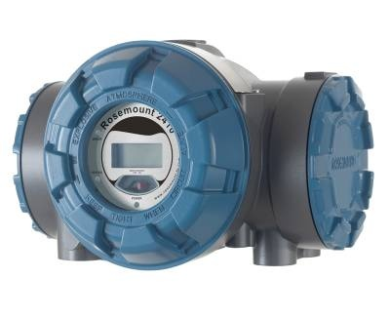
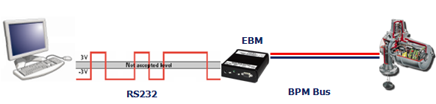
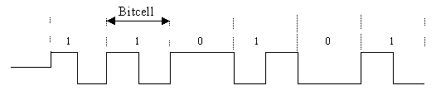
Electrical Interface Converters
Converts the electrical interface using same communication protocol
Westermo MA-45
RS232 → RS485
MA-45
RS232
RS485 (Sensorbus)
FBM
RS232 → TRL/2
FBM
RS232
TRL/2 Bus
EBM
RS232 → Enraf BPM

Slide 11
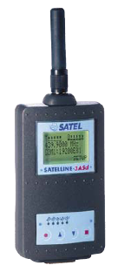
Radio modem
Converts the electrical interface to radio transmission
Radiomodem Satelline -3ASd
Acts completely transparent
Replaces cabling
Electrical interface
RS232
RS485, RS422
Up 19200 bit/s
Half duplex
Frequency
380-470 MHz
Range
Up to 40 km

Slide 12
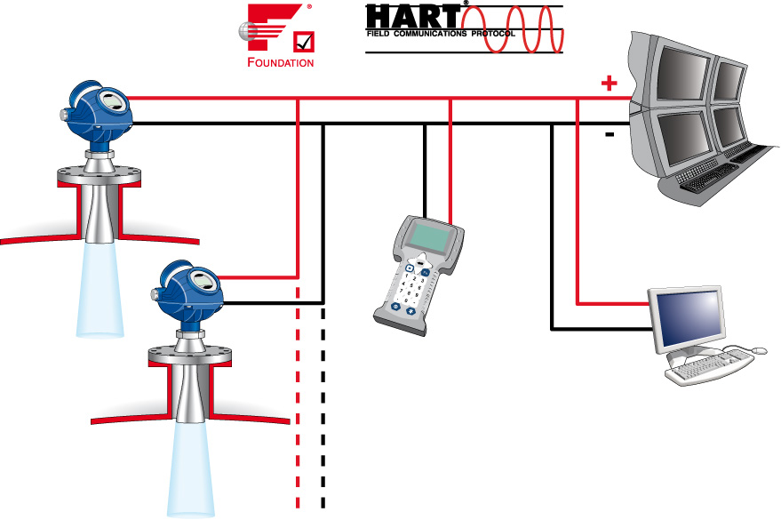
General Field buses
Supported by Rex & Pro
Hart
TRL/2 bus
RS485
Profibus DP
Foundation Fieldbus
Supported by Raptor
TRL/2 bus
RS485
Foundation Fieldbus

Slide 13

Hart
Developed to fit ’old’ 4-20 mA systems
Introduced by Smart transmitters
FSK super imposed voltage signal
1200 Hz = ’1’
2200 Hz = ’0’
Multidrop
1200 baud
Half duplex
Up to 3000 m
15 units / fieldbus
Current fixed to 4 mA
Address ’0’
Only one device possible on bus
Primary Value →4-20 mA
Other values via Hart
1
2
15

Slide 14
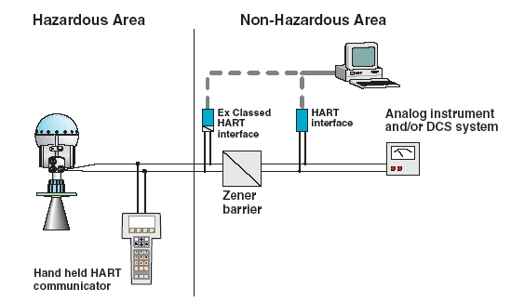
Hart, device example
Supported in Pro as Hart Slave
Analog output
Active / Passive
Non IS or IS Connection
Not all zener barriers allow HART communication

Slide 15
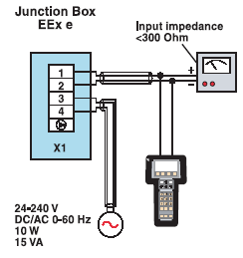
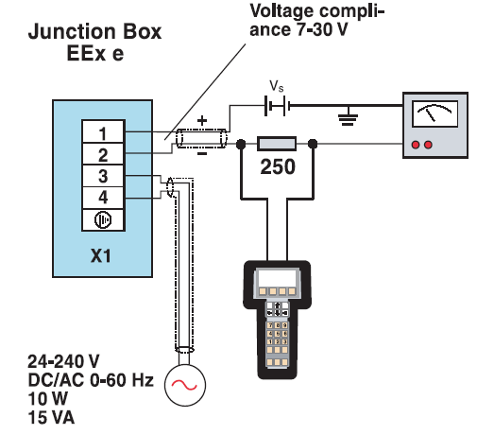
Hart, connection example
Connect and configured with
Hart Communicator 375
PC + Hart modem
Passive analog output
250 Ω resistor needed

Slide 16
Hart, multidrop
Supported in Rex as Hart Master
Analog input
IS Active input
Hart address 0-3 supported
Used for hybrid systems

Slide 17
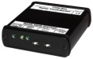

TRL/2 Bus
Rosemount Standard Bus
4800 baud
Half duplex
Up to 4000m
Multidrop
Non IS
2410 Tank hub
Communication Card: TRL2 Modem
Primary or Secondary slot
Modbus protocol
Rex
Communication Card: FCC ’Standard’
Modbus protocol
Pro
Communication Card: TM40
Not available for RMT 5600
Modbus protocol
FoundationFieldbus
FF
TRL/2
TRL/2
TRL/2
TRL/2
TRL/2

Slide 18
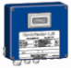
RS485
Rex
Communication Card: FCCIII
Up to 19200 baud
Modbus rtu protocol
GSI ASCII protocol
Non IS connection
Possible to connect 2210 DU
SDAU simultaneously
Pro
Communication Card: RS48
Modbus rtu protocol
Pro Sensorbus
IS connection
Connect 2210 DU
Configure gauge
RS485
RS485
2210 DU
RS485
RS485

Slide 19
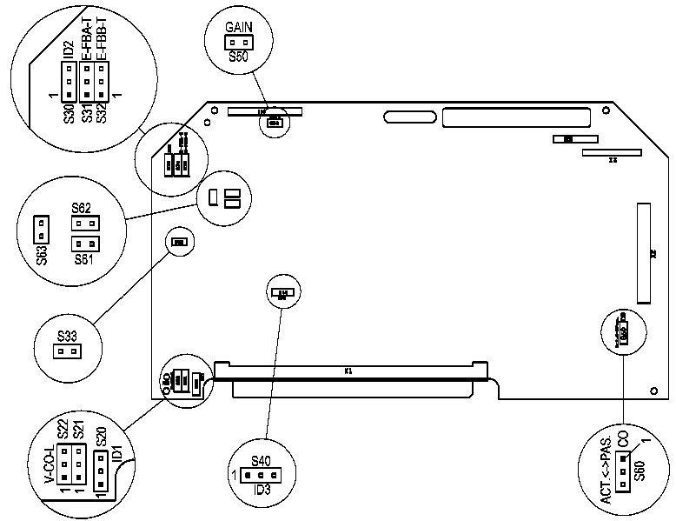
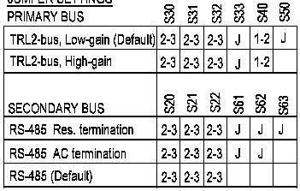
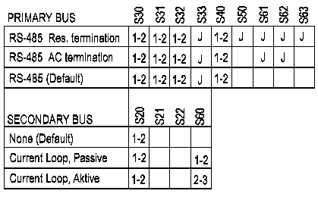
FCC setup
9150072-711

Slide 20
Profibus DP
Profibus DP
Based on RS485
Non IS bus
12 Mbit/s
Maximum 126 nodes
Profibus adapter needed
Rex: Mounted on Multi FCC
Pro: Mounted on TA43 card
Up to 1,5 Mbit/s supported
Address
Switches on Profibus adapter 1-99, or
In gauge software 1-126
RS485

Slide 21
Profibus DP
Transmitter variables
Level
Ullage
Level rate
Signal Strength
Volume
Avg and Spot temp
Observed density
Gas and Liquid Pressure
Water interface
RS485

Slide 22
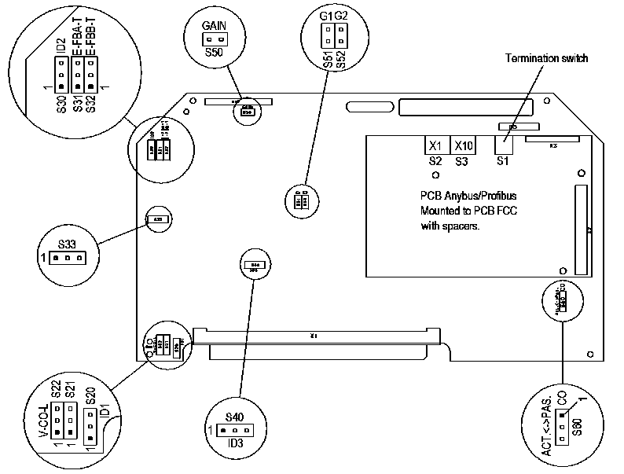
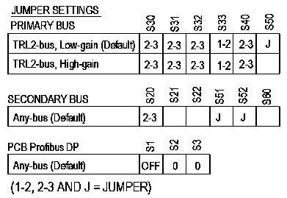
FCC setup Profibus

Slide 23

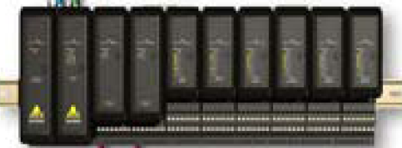
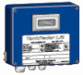
Foundation Fieldbus
Highly advanced fieldbus
Integrated intelligence
240 nodes / segment
65000 segment possible
HSE (DCS-SCADA)
High Speed Ethernet
100 Mbit/s
H1
Intrinsically safe
31,25 kbit/s
1900 m
Some devices can be powered from fieldbus
Raptor
Not Rex & Pro
HSE
Segment
H1

Slide 24
Foundation Fieldbus
Integrated intelligence in field bus interface
Resource Block
Information about the device
Type, SW version, operation state, diagnostics etc
Transducer Blocks
Configuraiton of unit
Antenna, R distance etc
Function Blocks
Outputs
Level, level rate, temp etc
Control functions
Logical functions, PID etc
HSE
Segment
H1

Slide 25
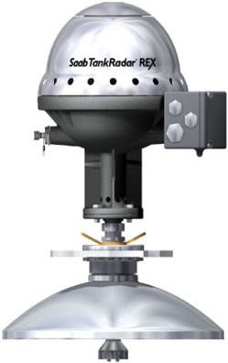

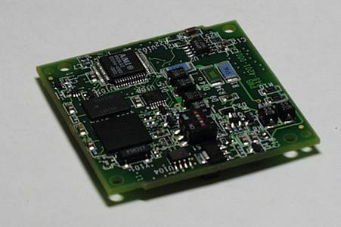
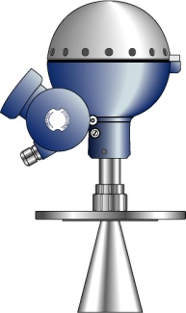

Foundation Fieldbus
FF Adapter card
Rex: Connected to SPC card
Pro: Connected on TA43 card
RMT 848 Output Board
FF gauges

Slide 26
Foundation Fieldbus
Rex & Pro connections
H1 bus supported
Non IS
IS
16 devices / segment
Due to power consumption
Addressing (20-35 permanent)
Rex & Pro are supported in DeltaV
Automatic dectected
Configuring
Monitoring
HSE
Segment
H1

Slide 27
Emulation

Slide 28
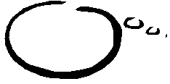

What is emulation?
Ability of a device to imitate another device
Device using emulation tricks the software in the other device
Enraf... OK!
Emulation!!!
REX
Enraf HOST
Level please?
Enraf?
Yes!
OK, 15.6m

Slide 29
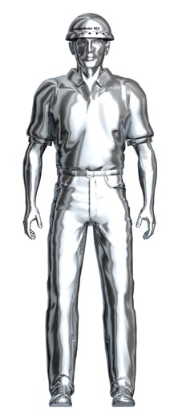
Why emulation?
Opens up closed systems
Gives the customer an alternative and frees him from old systems and fieldbuses
New technology within old systems
Facilitates a step by step upgrade and modernization, possibly using maintenance budget
Site upgrade in sequences
Mix of brands on site
Not locked to one and the same manufacturer
Possible to mix type of level gauging techniques
Try out...
Possible to evaluate equipment within an existing system

Slide 30
Emulation levels
Gauges
Data Collectors
Control Room
Gauges
Control room
Data collectors
Notes:
Snygga till bild

Slide 31
Gauge Level - Rex
Rex Open System Design ’Plug n Gauge’ makes it easy to adapt it emulating other vendors
Fieldbus electrical interface
Communication Protocol
Utilization of existing power source
Power from fieldbus in some emulations
Emulation benefits
Replace old gauge with Rex, using the same cables
Old communication units and software can remain
Investment cost reduced to a minimum
Easy installation
Install and configure using existing cables
The operator will not see any difference
No change of operators interface
The Rex will appear as a ”normal” device

Slide 32
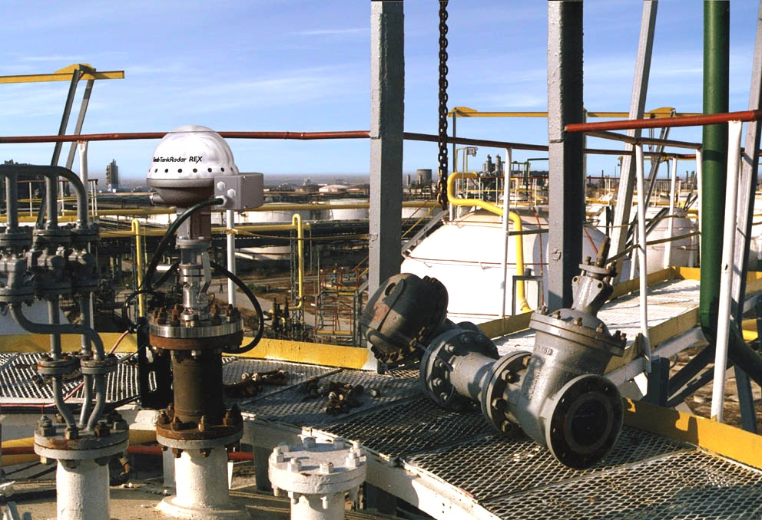
Gauge Level - Rex
Rex emulates most common ATG protocols
Enraf (GPU)
L&J
Whessoe
Tiway
GPE
VAREC
GSI
Sakura
TIC
Auxitrol

Slide 33
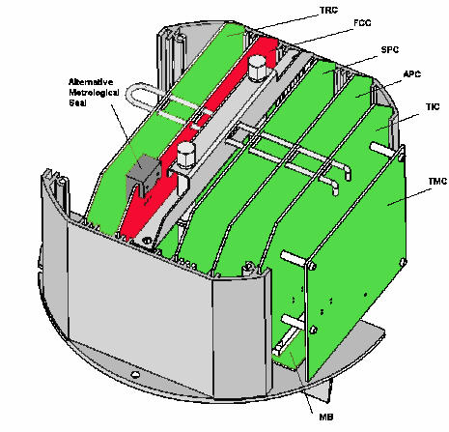
Gauge Level - Rex
Rex field bus interface
Handled by FCC board (Field Communication Card)
9150072-675 for Rosemount TRL/2 bus only
9150072-673 Multi FCC
9150072-711 FCCIII
Some field buses need extra adapter card

Slide 34
Gauge Level - Rex
Rex emulation software
Handles all emulation protocols
Makes Rex look like another device (emulation)
Configure emulation address, baud rate etc..(depends on emulation)
Rosemount TRL/2 address and Emulation address not the same
Note: Some emulation interfaces will use the wires for the “second relay” output limit the relay option to only one relay
Emulation

Slide 35
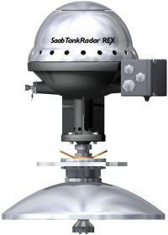
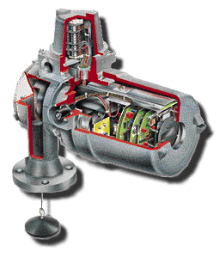
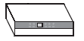
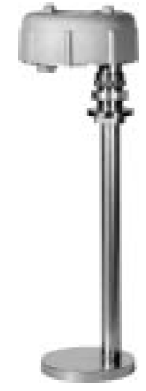
REX in a Enraf system
Enraf PC
SW Entis
CIU Prime
CIU Prime
Existing cables!
Configure Enraf address
Plug n Gauge
Enraf 873 SmartRadar
Enraf 854 Servo

Slide 36
Emulation levels
Data collectors

Slide 37
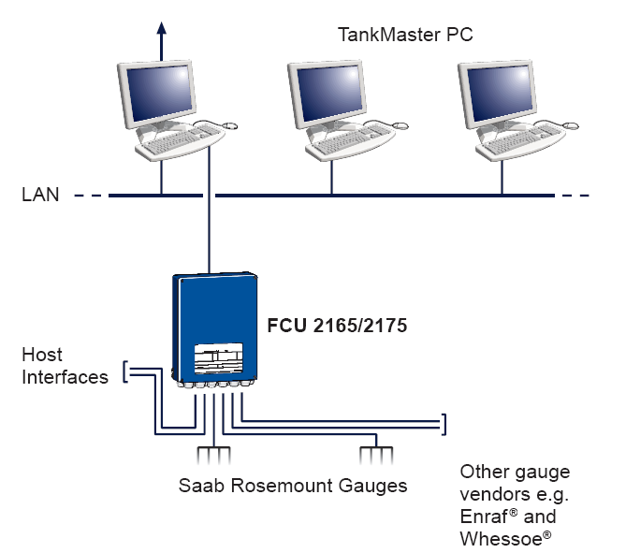
Data collector level
FCU2165/75
Developed for emulation purpose
Collects data from other gauge vendor equipments
Provides data to other vendor HOSTS
Simultaneous data collecting using different field bus interfaces and protocols
Concentrates all data to one point
FCU acts as protocol converter
Combine different gauge vendors and present all data in one or several HOSTS
TankMaster
Entis
Foxboro etc

Slide 38
FCU 2165/75 drivers
Fieldbus
Rosemount FCU/FBM
TRL2/Rex system
Enraf CIU/BPM
802/811/813 GPP Servo
811/813/854 GPU Servo
873/971/973 GPU RTG
Krohne
BM70 RTG
Whessoe WM500
1071 Outstation
1311 Transmitter
1140 Servo
Whessoe WM550
1315 Transmitter
ITG 50/60/70 Servo
Motherwell 4000/2800
2800 Servo
GPE
Modbus master
Analog/Digital I/O
Hosts
TankMaster
Enraf CIU 858 Slave
Emulates CIU 858
Enraf ENTIS XL
Enraf MICROLECT
FoxBoro I/A
Modbus Slave

Slide 39

FCU2165/75 in a Enraf system
FCU2165
Enraf PC
SW Entis
Emulating CIU Prime
CIU Prime
CIU Prime
Tank Master PC
Enraf 854 Servo
Enraf 873 SmartRadar

Slide 40
Enraf GPP system
FCU 2165/75 can emulate an Enraf microlect
Microlect not supported by Enraf anymore
GPP
Not for REX Emulation
GPP

Slide 41
Emulation levels
Control room

Slide 42
Control Room Level
TankMaster collects field data from other vendor’s equipment
Enraf
CIU Prime
CIU 858
Direct from gauges
Endress+Hauser
MDP-II
DS4
TankMaster collects data from PLC/Host systems
Generic Modbus master
Generic OPC master
Notes:
Benefits:
Provides new operator interface
Adds new functionality
Possible to test TankMaster and runn old software in parallell

Slide 43
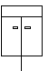
Tank Master in a Enraf system
Enraf PC SW Entis
CIU Prime
CIU 858
Tank Master direct to CIU
Enraf 873 SmartRadar
Enraf 854 Servo

Slide 44
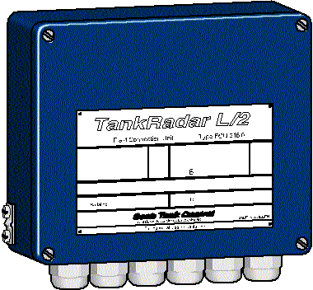
Tank Master in a Enraf system
Enraf PC
SW Entis
CIU 858
Enraf 873 SmartRadar

Slide 45
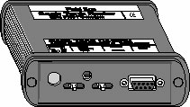
Tank Master in a Enraf system
Enraf PC
SW Entis
EBM
Notes:
EBM can be used for direct connection
Up to 10 devices.

Slide 46
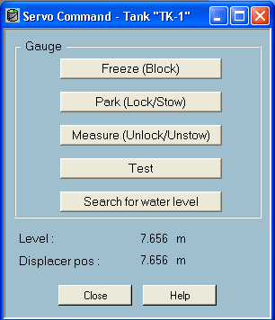
Service commands to servo gauges
Servo commands used in Entis are supported in TankMaster
Freeze
Stops servo
Park
Raise displacer to park position
Might be necessary during pumping
Measure
Unlocks servo if parked or blocked
Test
Raises displacer for 5 secs then lower it again
Search for water level

Slide 47
Competitor system: Enraf
GPP System
Entis+
Host
CIU 858
GPP
Not for REX Emulation
802
Microlect
Temperature
Sensor
802
877
811
813
811
Temperature
Sensor
813
Temperature
Sensor

Slide 48
Competitor system: Enraf
GPU system
Entis+
Entis Pro
CIU
CIU 858
Plus
CIU
Prime
811
862
811
862
813
863
813
863
854
864
854
864
873
865
873
865
971
877
971
877
973
878
973
878
977
977

Slide 49
Enraf Emulation
Rex can emulate
811
813
854
872
873
All GPU protocols
Transmitter variables
Level
Temp
Pressure
Status
Density
Relay
Water interface

Slide 50
REX in an Enraf system
Enraf PC SW Entis
CIU Prime
CIU Prime
Enraf 854 Servo
Enraf 873 SmartRadar

Slide 51
Mechanical change
Tank connection might need to be modified
Depends on antenna

Slide 52
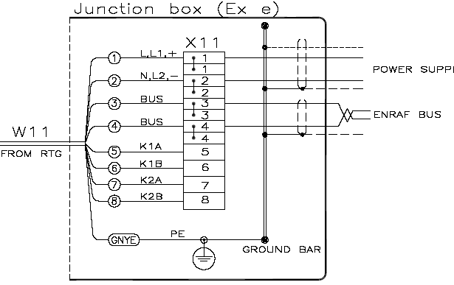
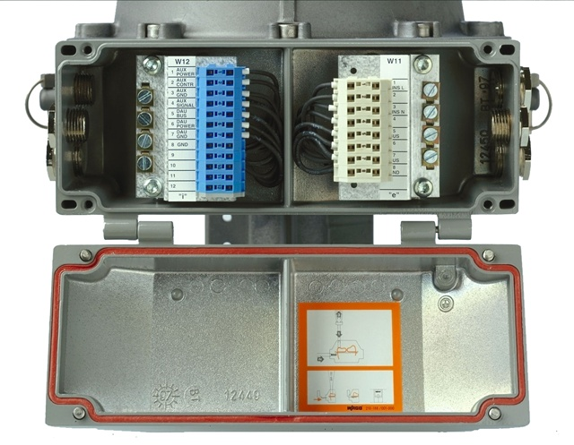
Electrical Connection
Same cabling used
Power
Bus
Enraf bus
BPM (Bi Phase Mark)
2 wire bus

Slide 53
Multi FCC Setup
Use Input Register #1152 to verify correct identification
Bit 0 = Enraf Emulation
Gain ctrl
Jumpers

Slide 54
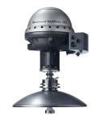
Configure REX in a Enraf system
Enraf PC SW Entis
CIU Prime
CIU Prime
Enraf 873 SmartRadar
Enraf 854 Servo

Slide 55
Configure REX in a Enraf system
During configuration disconnect the field bus from the CIU and connect the EBM to the field bus
CIU Prime
FB
RS-232

Slide 56
EBM
RS232 to Enraf BPM converter
For configuration of Rex gauge over Enraf bus
Direct connection of Enraf gauges (up to 10 pc)
2 switches
Mode: Modbus/Normal (Enraf)
Baud rate: 1200 / 2400
Signal gain control via internal jumpers
10%
35%
100%
Fieldbus
Modbus/Normal (Enraf) switch
1200/2400 baud switch
PC Connector

Slide 57
Configure Rex in an Enraf system
Rex with Enraf emulation from factory:
Field bus interface: BPM (Enraf)
Protocol mode: Modbus (Rosemount)
Modbus mode
Configure gauge
Switch to Enraf mode
Enraf mode
Emulating specified Enraf gauge
Switch to modbus mode
Note!
Modbus mode will always be active in 30 sec after powering up

Slide 58
Configure Rex in an Enraf system
Emulation configuration menu available in WinSetup for Enraf emulation

Slide 59
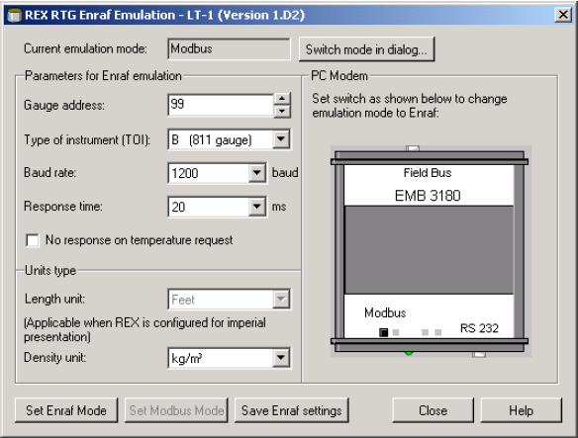
Configure Rex in an Enraf system
Gauge address
Emulation address 0-99
Type of instrument (TOI)
B (811 GPU protocol)
Most common
C (813 MTG GPU protocol)
@ any device
Baud rate
1200/2400
Response time
Default 20 ms
Increased if CIU is connected via modem to HOST
No response on temp request
If an Enraf 877 (IDAU) is connected

Slide 60

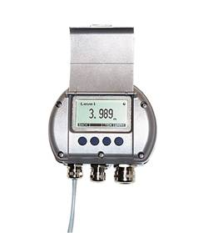
Rex in an Enraf system
Enraf
CIU
SDAU
14 Temp
6 Temp
or...
RDU
Enraf 877
Independent
“DAU”
Temp

Slide 61
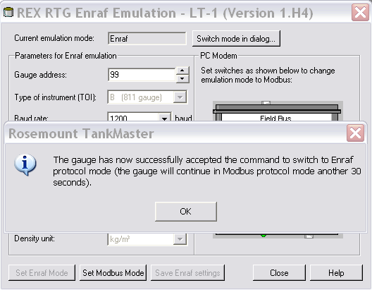
Configure Rex in an Enraf system
When all settings are done...
Save Enraf settings
Stores all settings in Rex holding register
Switch to Enraf mode
Set Rex to Enraf mode
A message will appear telling you change of mode is successful
Note! The gauge will continue in modbus mode for 30 seconds before switching!

Slide 62
Configure REX in a Enraf system
Enraf PC SW Entis
CIU Prime
CIU Prime
Enraf 873 SmartRadar
Enraf 854 Servo

Slide 63
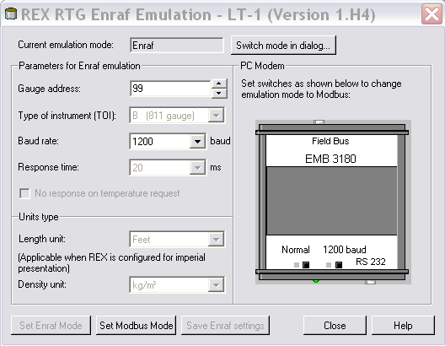
Switch to Modbus mode
In case a change in configuration need to be done
Calibration
Disconnect CIU or gauge from Enraf bus
Set EBM in Normal mode
Correct baud rate
Go to Enraf emulation menu
Enraf
Current emulation mode
Set correct gauge address
Baud rate
Set modbus mode
A message will appear telling that switch of mode is successful

Slide 64
Switch to Modbus mode
Set switch on EBM to modbus
Close the Emulation window
Open Emulation window again
If there is communication all parameters will be read
Gauge address
TOI
Baud rate
Response time
Change settings in gauge and switch back to Enraf mode

Slide 65
Enraf paramters
TOI = Type of Instrument
B = 811 with GPU protocol
C = 813 MTG GPU protocol
B is most common but new gauges can be either B or C
TOR = Type of Request
A = Alarm status
B = Alarm status and level data
C = Alarm status and temperature data
D = Alarm status, temp and level data
Can be found inthe Enraf emulation – System description

Slide 66
Nomenclature
Float gauge = totally mechanical, with floater
Servo gauge = mechanical / electrical, with displacer
Transmitter/Gauge – not the same thing!!!
Displacer = on servo gauge, does not float
Sensing head= Whessoe, measures temperature also
Test gauge = raise displacer a short moment (check if stuck or any other reason)
Scans = send displacer into product to scan for density or temperature

